Slide 1
Theory Practice Correspondence

Slide 2
Software Development Life Cycle(SDLC)

Slide 3
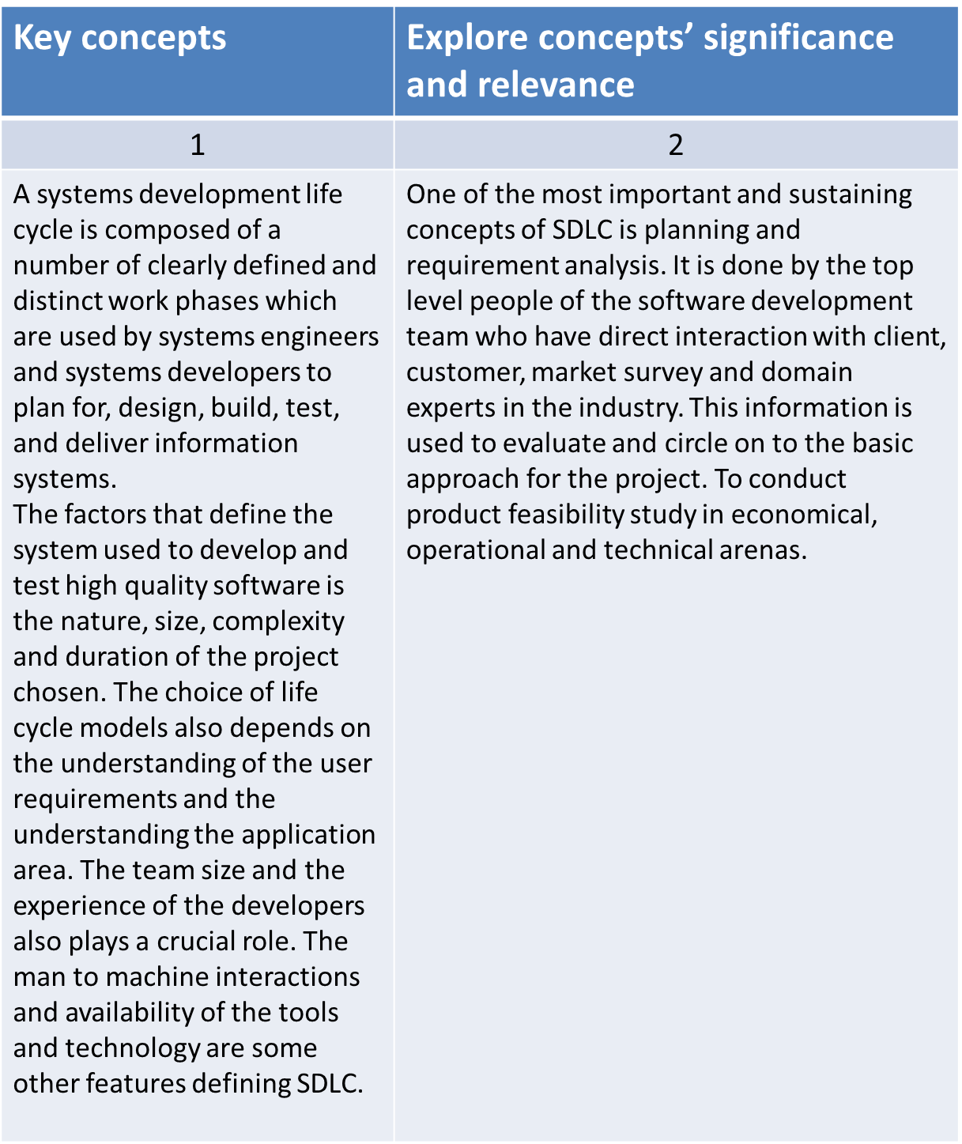

Slide 4
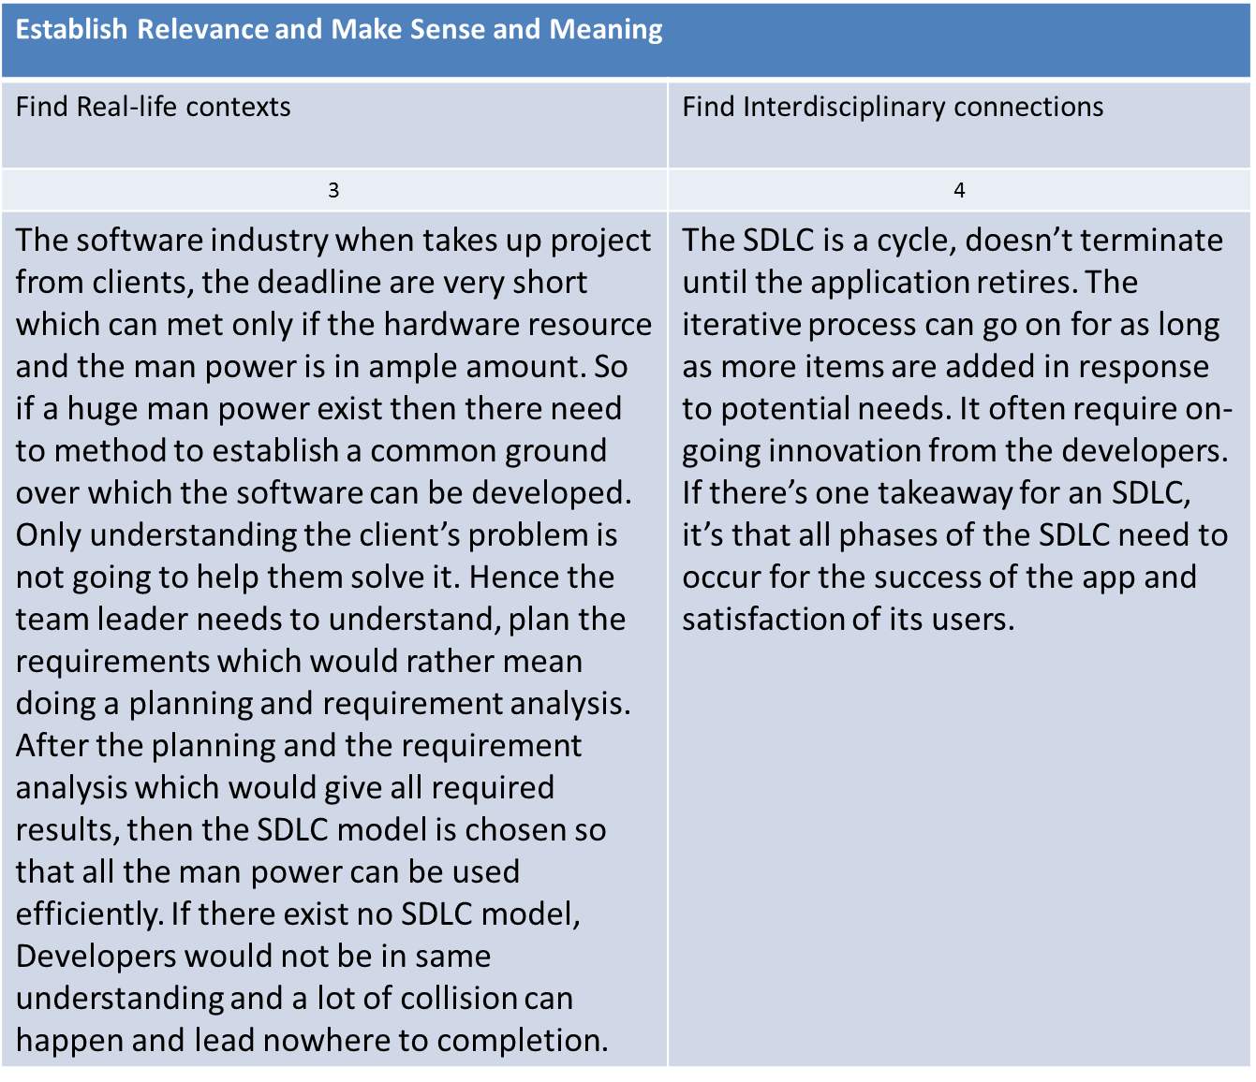

Slide 5
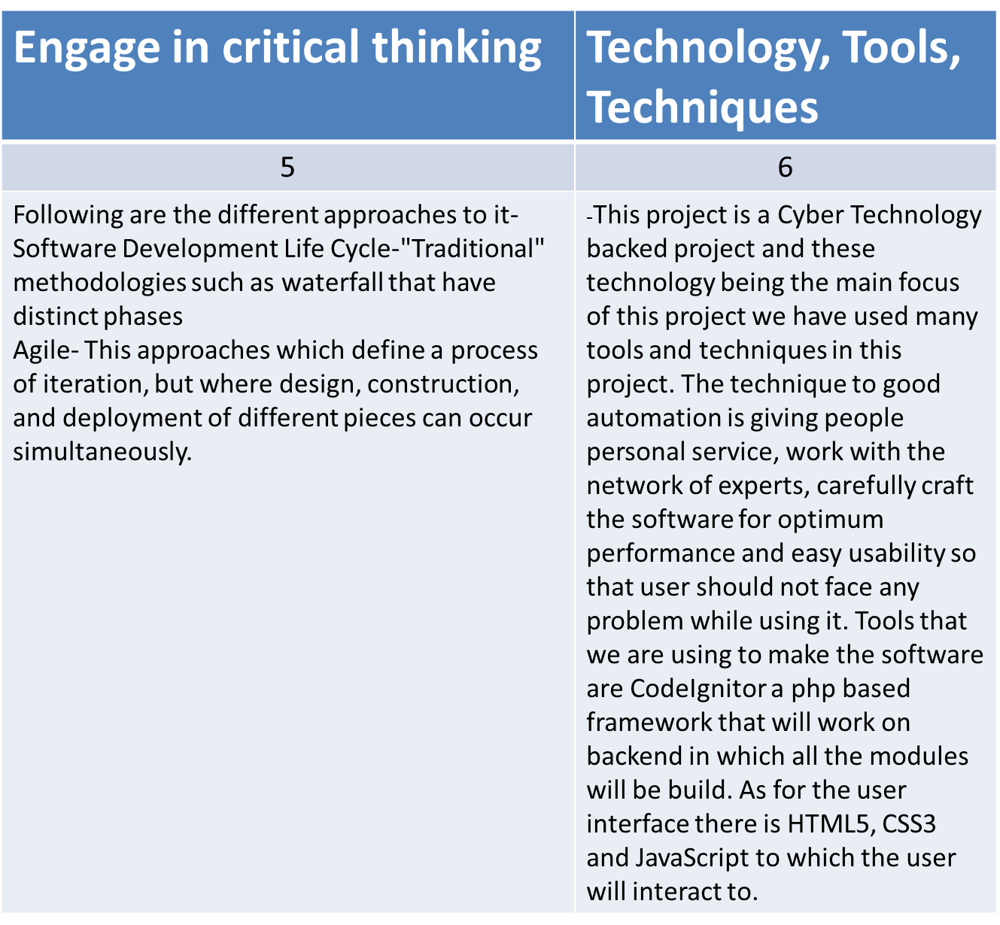

Slide 6
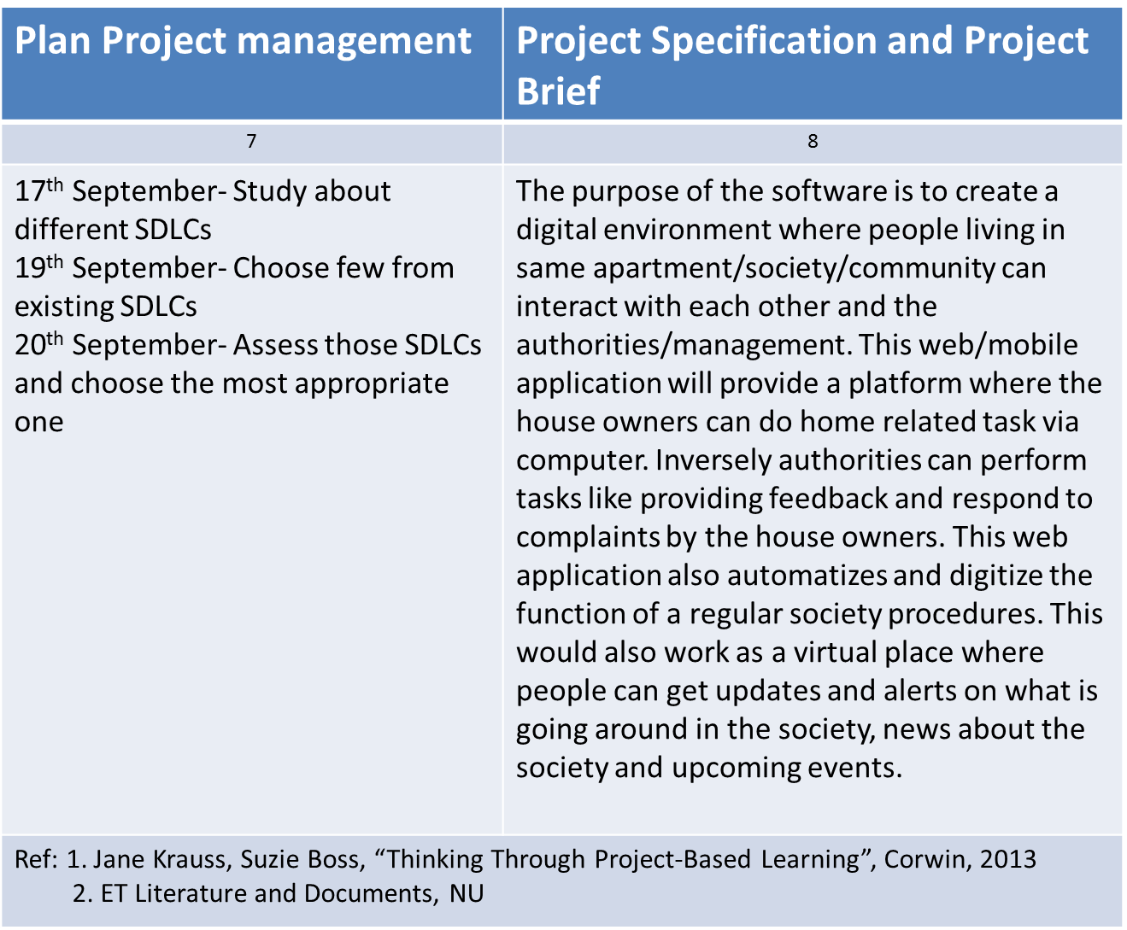

Slide 7
Software development methodologies

Slide 8
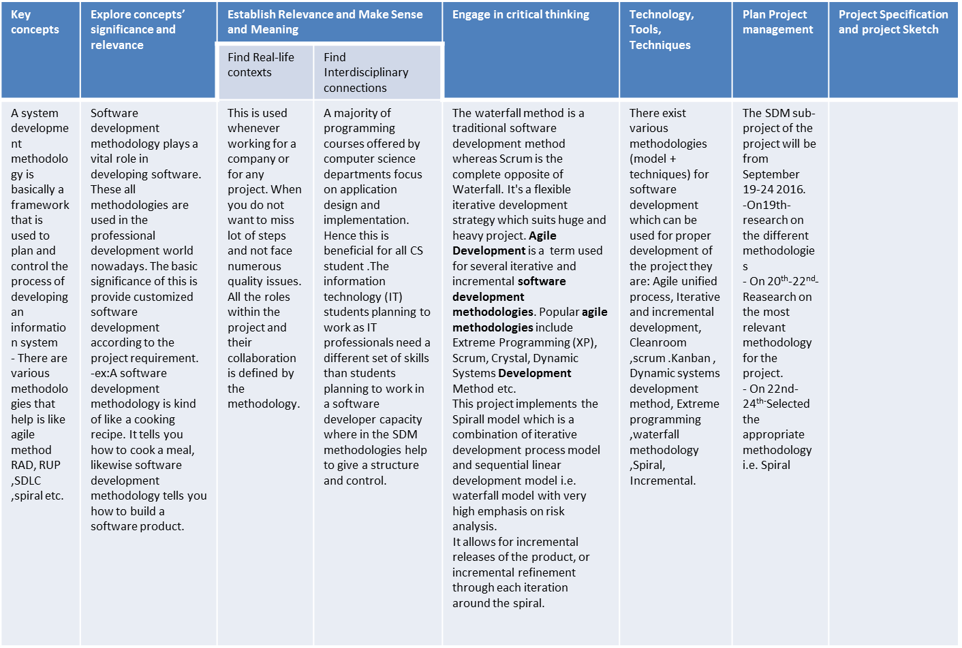
The purpose of the
software is to create a
digital environment
where people living in
same apartment/
society/community
can interact with each
other and the
authorities/
management. This web
/mobile application will
provide a platform
where the house
owners can do home
related task via
computer.
Inversely authorities
can perform tasks like
providing feedback
and respond to
complaints by the
house owners. This
web application also
automatizes and digitize
the function of a
regular society
procedures. This would
also work as a virtual
place where people
can get updates and
alerts on what is going
around in the society,
news about the
society and upcoming
events.

Slide 9
Requirement Analysis

Slide 10
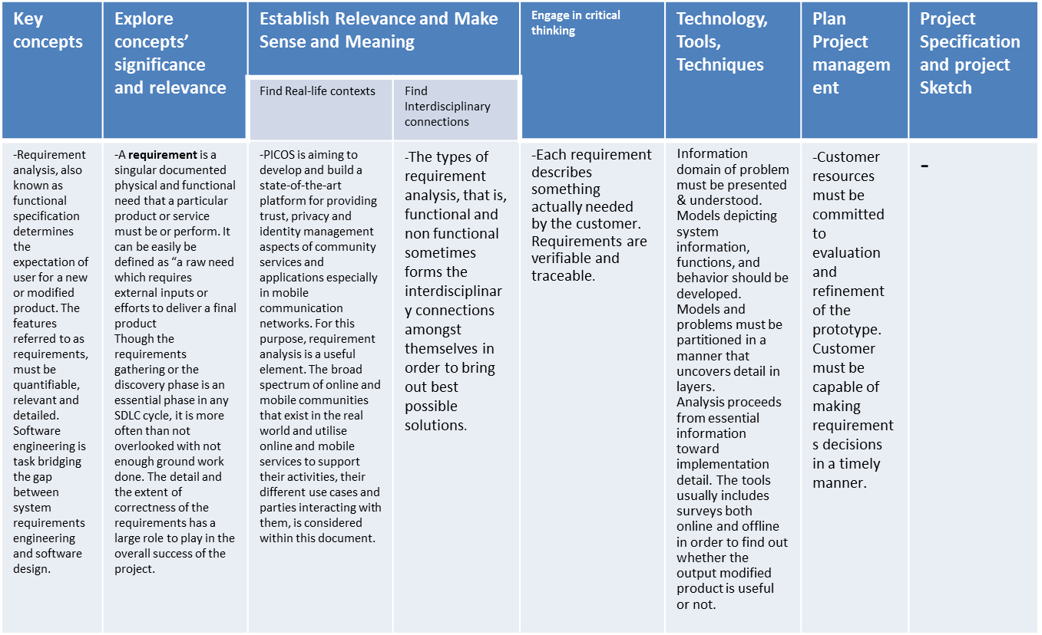
The purpose of the
software is to create a
digital environment
where people living in
same apartment/
society/community
can interact with each
other and the
authorities/
management. This web
/mobile application will
provide a platform
where the house
owners can do home
related task via
computer.
Inversely authorities
can perform tasks like
providing feedback
and respond to
complaints by the
house owners. This
web application also
automatizes and digitize
the function of a
regular society
procedures. This would
also work as a virtual
place where people
can get updates and
alerts on what is going
around in the society,
news about the
society and upcoming
events.

Slide 11
System design

Slide 12
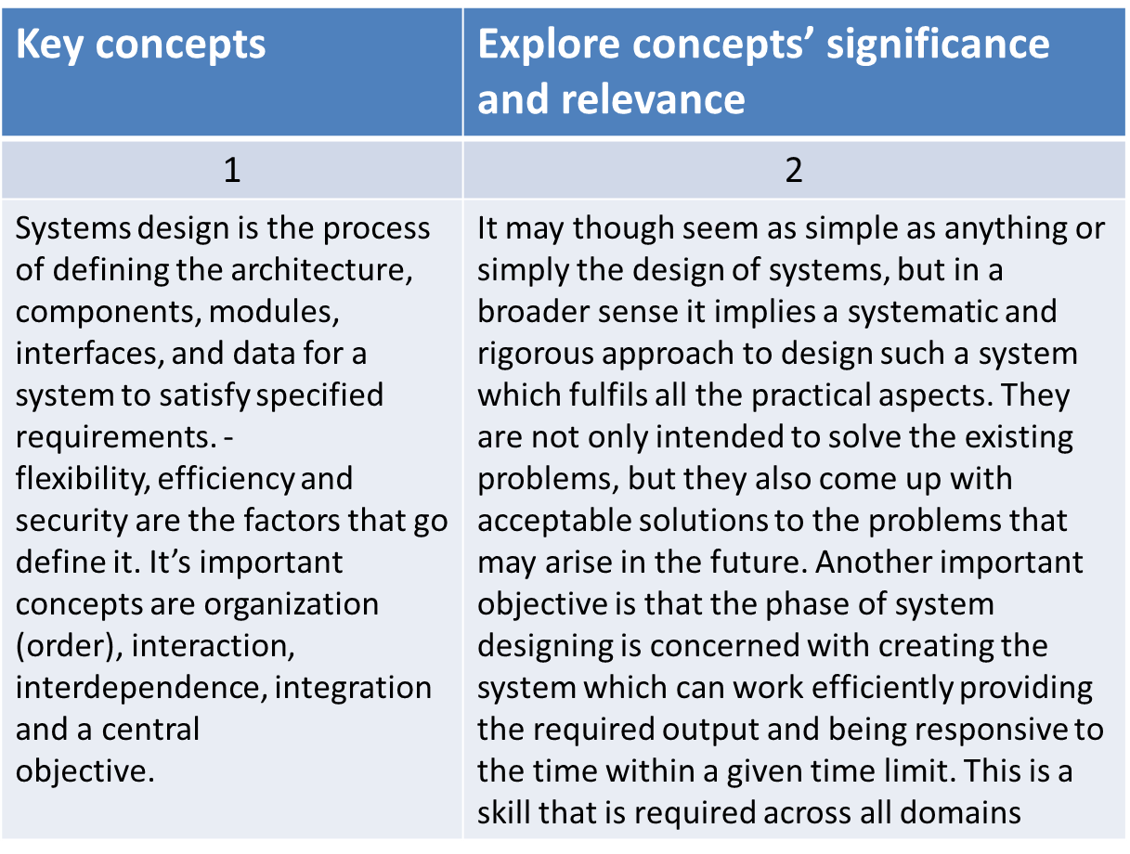

Slide 13
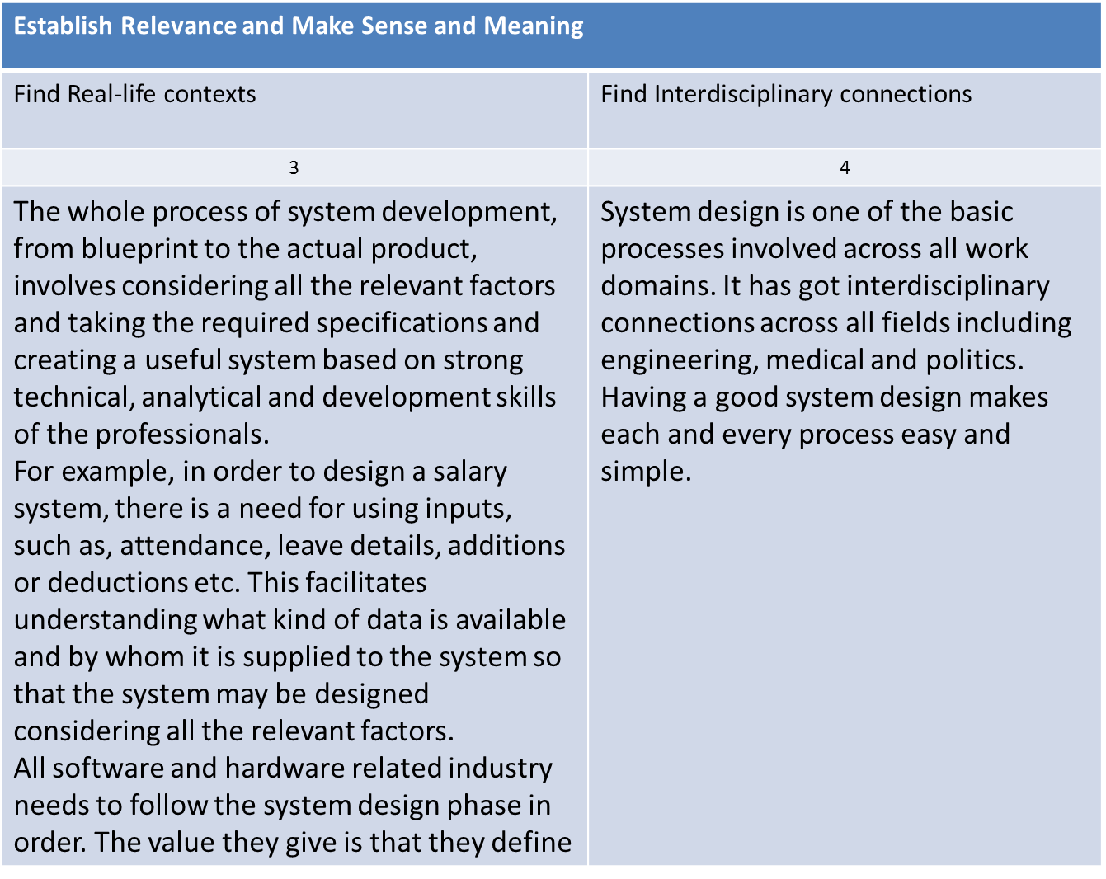

Slide 14
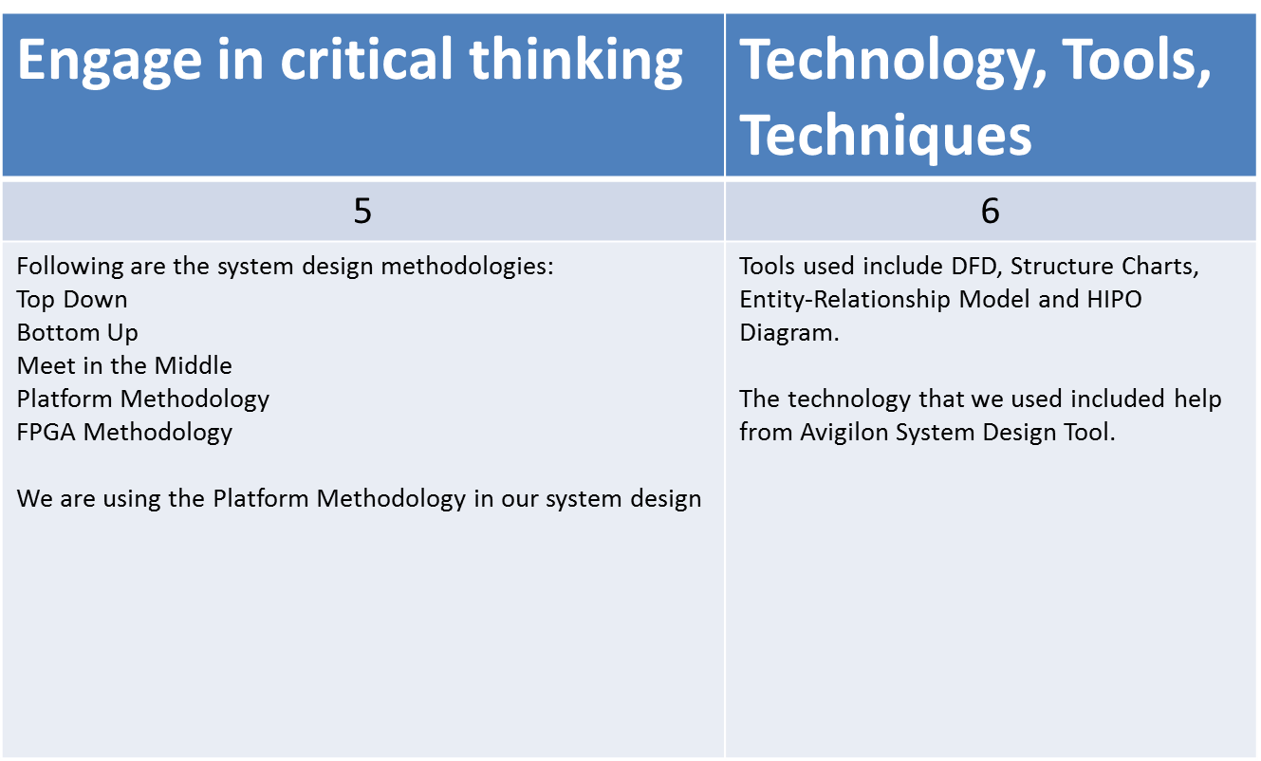

Slide 15
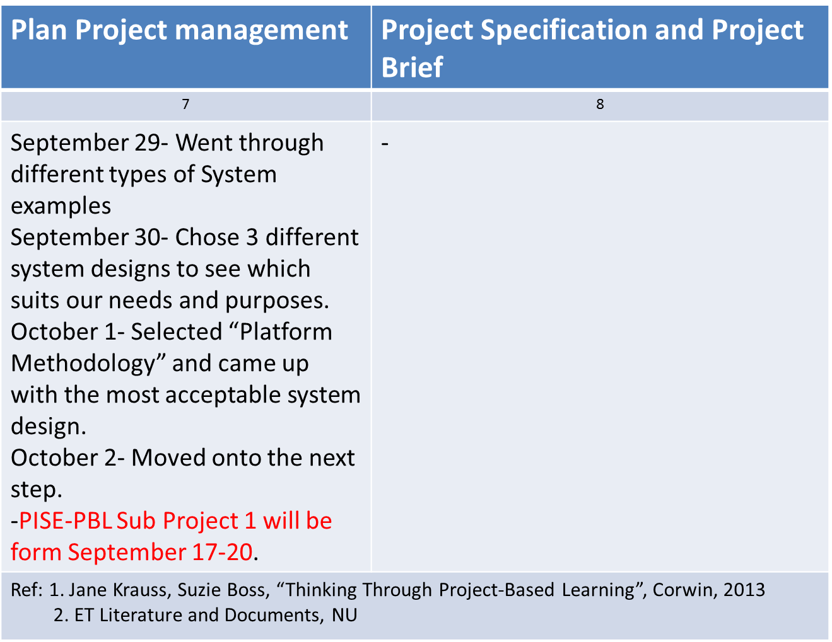
The purpose of the software is to create a
digital environment where people living in
same apartment/society/community
can interact with each other and the
authorities/management. This web/mobile
application will provide a platform where
the house owners can do home related task
via computer. Inversely authorities
can perform tasks like providing feedback
and respond to complaints by the
house owners. This web application also
automatizes and digitize the function of a
regular society procedures. This would
also work as a virtual place where people
can get updates and alerts on what is going
around in the society, news about the
society and upcoming events.

Slide 16
Coding

Slide 17
Key concepts | Explore concepts’ significance and relevance | Establish Relevance and Make Sense and Meaning |  | Engage in critical thinking | Technology, Tools, Techniques | Plan Project management | Project Specification and project Sketch
 |  | Find Real-life contexts | Find Interdisciplinary connections
-The life cycle of coding is : code, find the bug and keep on correcting the code until you get your desired output. -Coding is basically the process of assigning a code to something for classification or identification. -Codes are systems used by people to establish appropriate communication. Code switching is one of the common approaches that people use to code | -Computer programming jobs may be declining, but coding is becoming the most in-demand skill across industries. -Coding has become a core skill that bolsters a candidate’s chances of commanding a high salary. -The best product in the world is meaningless if nobody knows about the code. So coding and its phases matters a lot. | -The code related to our project, that is ApartMaint, basically creates a web application that helps the people living in the apartment/ building in solving their day to day life problems. Like if they have to register any complaint regarding the maintenance or cleanliness of the apartment, they no longer have to visit the concerned authorities office to get it registered or solved. They can simply get the job done with a click of the button. And this is just one of the many services that our application provides. | Coding is a process that involves logical thinking and appreciation of concise and complete techniques. Once you become competent in coding you start becoming good in details. All these skills- Logical thinking, attention to details, etc are the skills that help a person immensely in all the work domains. | -Coding has various life cycle methodologies. In the real world the phases of coding are chosen according to the demand of the application/software we are willing to develop. -Now further, the phases of coding are analyzed. Phases of coding generally include: implementing the design, typing in the code, and recording the coding time in the time recording log. | -Superior coding techniques and programming practices are hallmarks of a professional programmer. The bulk of programming consists of making a large number of small choices while attempting to solve a larger set of problems. How wisely those choices are made depends largely upon the programmer's skill and expertise. The only tools and techniques used while coding are the logical thinking of the coder and how well can it handle the complexities using his/her coding skills. | -The management of the project is heavily dependent on the time taken by the programmer to do the coding of the entire software. It is a continuous process though As debugging of the software continues until the end, it took around 3rd to 16th October to write the base code. | -The purpose of the software is to create a digital environment where people living in same apartment/society/community can interact with each other and the authorities/management. This web/mobile application will provide a platform where the house owners can do home related task via computer. Inversely authorities can perform tasks like providing feedback and respond to complaints by the house owners. This web application also automatizes and digitize the function of a regular society procedures. This would also work as a virtual place where people can get updates and alerts on what is going around in the society, news about the society and upcoming events.

Slide 18
Testing

Slide 19
Key concepts | Explore concepts’ significance and relevance
1 | 2
Testing is the part of SDLC where the code is ready and we look for errors that could have been looked over during coding phase. Testing involves checking for errors, bugs skipped during coding phase. Mostly testing phase involves the debugging phase as errors are resolved by debugging phases. | Testing phase is important because it works on different level than any other phase. This is because of the reason that all the application is build on the coding part but there may be changes as per client or something may not be working as per the need. These things will be resolved during this phase. For some code to work as usual this phase helps in debugging and finding problems which will help smooth running of the software when delivered.

Slide 20
Establish Relevance and Make Sense and Meaning
Find Real-life contexts | Find Interdisciplinary connections
3 | 4
Testing in reality is most important part after coding as after coding we have to see what And where all the mistakes are and what is working and what is not. Testing also helps in integration and maintaining the integrity on different platforms. Testing phase also takes the approach to find and report bugs which can be problematic if not reported and could cause problems to user. | Testing extends to working as it helps in integrating the software with the available hardware in the market. This will involve a research in market trends which all hardware is used and is our project tested and working on them. Also this should not be restricted to the new technology, but also to the future technology for sustainability.

Slide 21
Engage in critical thinking | Technology, Tools, Techniques
5 | 6
Error testing: This part of testing is used to find errors and mishandles which occur during the execution of the code. Equivalence testing: This testing is for checking the the values and if assumed values are there in the variables assigned. Visual Checking: This checking is done so as to ensure that the application is same throughout when we make a transition from platform to platform. | Test Cases: Writing test cases for different functions which are to be tested against different input for different outputs. Using codeIgniter inbuilt library and php unit for testing. Debugging with phpStorm debugger.

Slide 22
Plan Project management | Project Specification and Project Brief
7 | 8
24th- 28th October : Error testing of the code. Checking for errors in database handling. 29th October- 9th November: Code Testing phase. Checking for errors in post and get data. 9th - 13th November: Final Debugging by our side. 13th November: Errors proposed by client. | -The purpose of the software is to create a digital environment where people living in same apartment/society/community can interact with each other and the authorities/management. This web/mobile application will provide a platform where the house owners can do home related task via computer. Inversely authorities can perform tasks like providing feedback and respond to complaints by the house owners. This web application also automatize and digitize the function of a regular society procedures. This would also work as a virtual place where people can get updates and alerts on what is going around in the society, news about the society and upcoming events.
Ref: 1. Jane Krauss, Suzie Boss, “Thinking Through Project-Based Learning”, Corwin, 2013 2. ET Literature and Documents, NU

Slide 23
Software Project Management

Slide 24
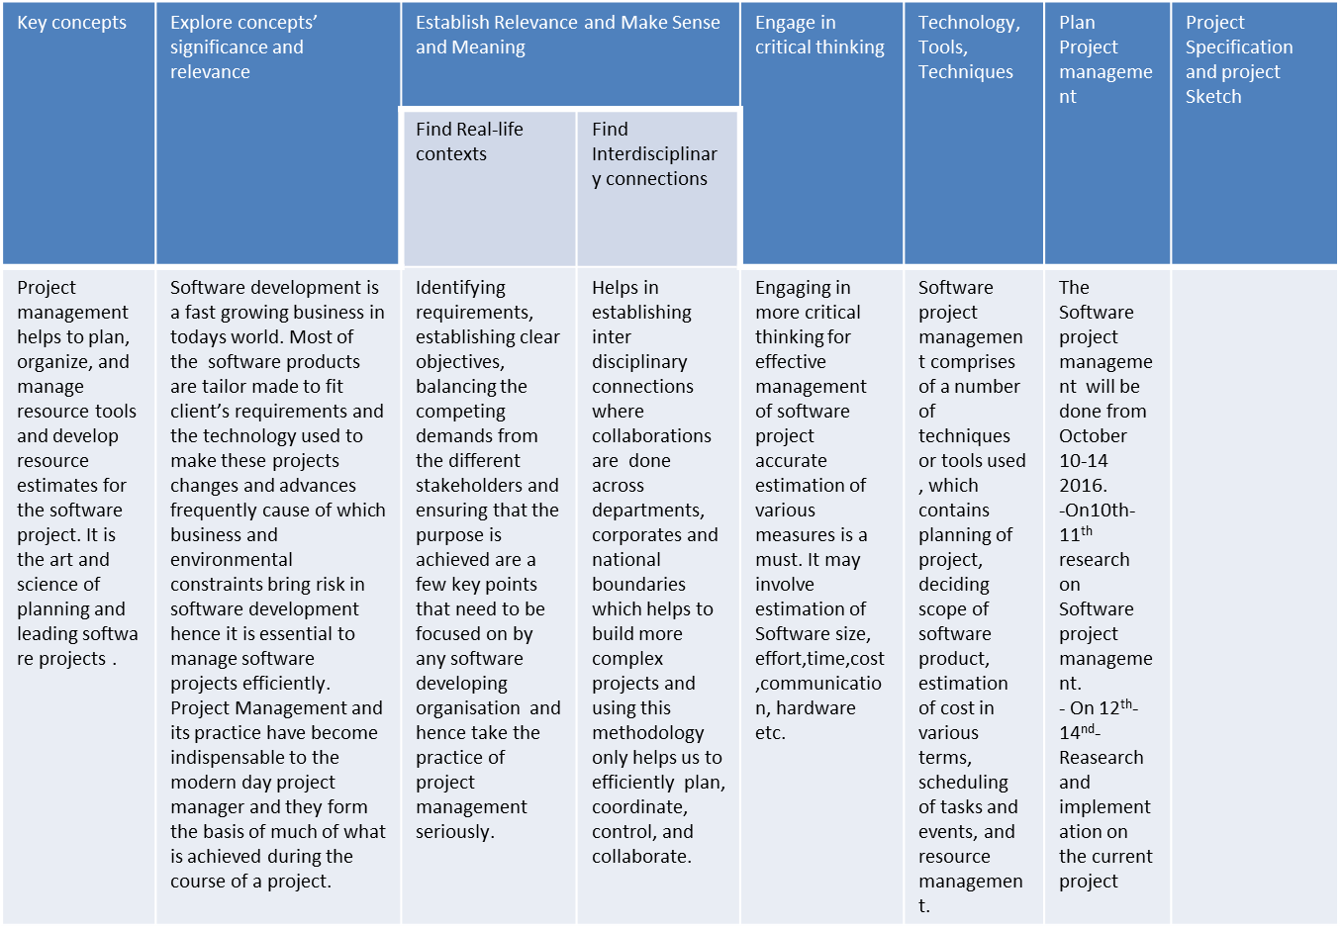
The purpose of the
software is to create a
digital environment
where people living in
same apartment/
society/community
can interact with each
other and the
authorities/
management. This web
/mobile application will
provide a platform
where the house
owners can do home
related task via computer.
Inversely authorities
can perform tasks like
providing feedback
and respond to
complaints by the
house owners. This
web application also
automatizes and digitize
the function of a
regular society
procedures. This would
also work as a virtual
place where people
can get updates and
alerts on what is going
around in the society,
news about the
society and upcoming
events.

